Slide 1
Statistics 367-1-4361
Lecture 12: Reproducibility
Opher Donchin

Slide 2
12.1 Scientific knowledge
What is the process through which scientific knowledge
is actually produced?

Slide 3
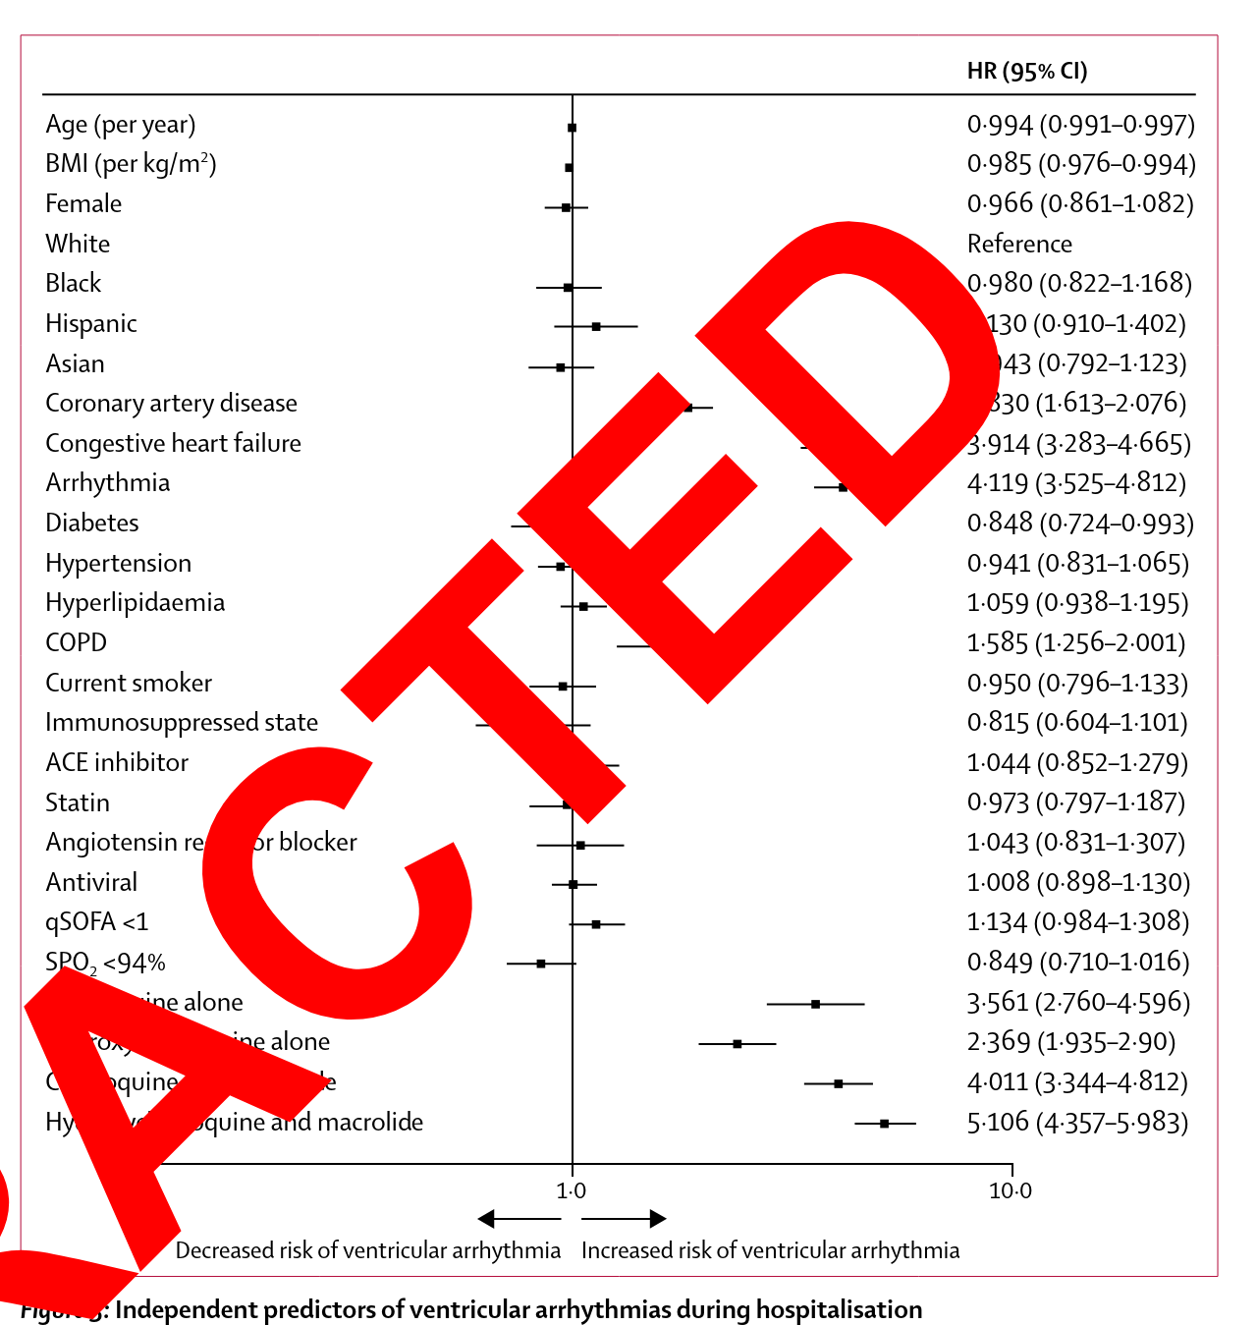
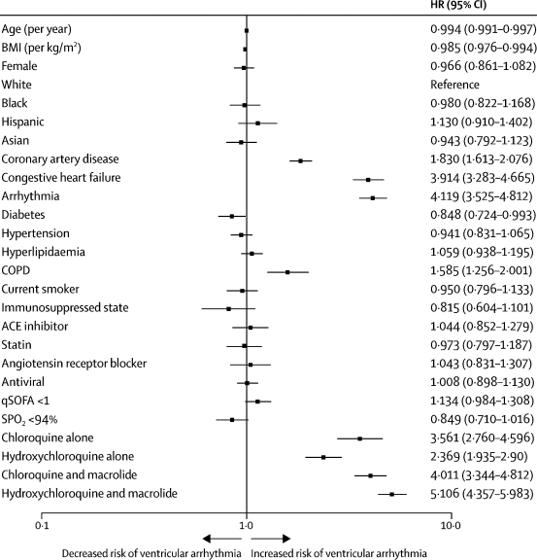
Science is not perfect
Mehra The Lancet 2020, retracted 2020, doi:10.1016/S0140-6736(20)31180-6
Hospital records
96,000 covid patients
14,888 received chloroquine
81,144 did not
No covid benefit
Increased risks of cardiac arrythmia
Immediate suspension of research
Private data collection company
Would not provide data to authors
Authors asked for retraction
Subsequent work
Does not support effectiveness of chloroquine
Supports minor cardiac effects
2

Slide 4
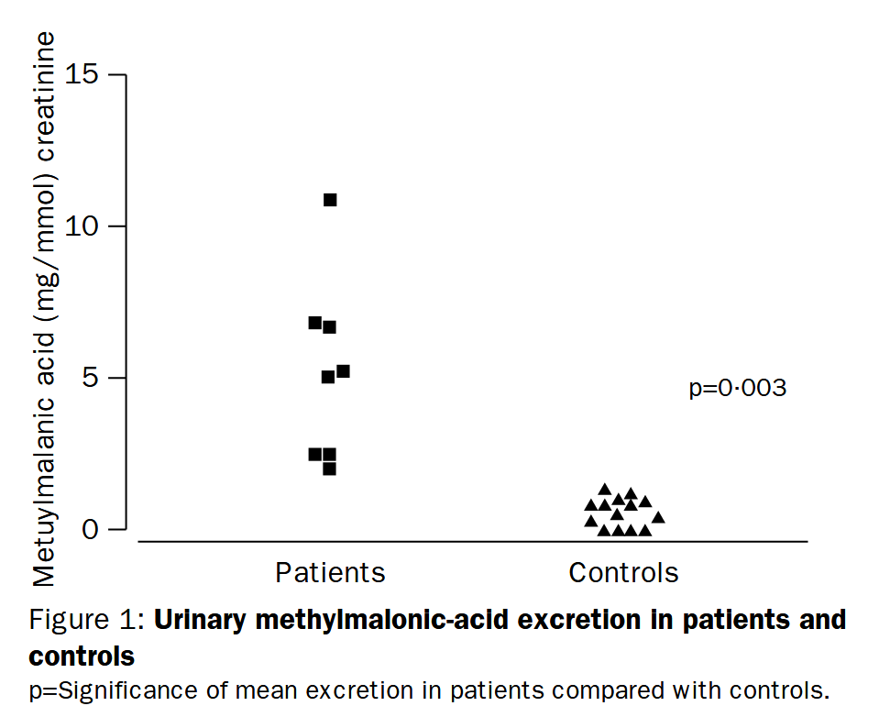
Sometimes it takes a long time to fix
Wakefield The Lancet 1998, retracted 2010, doi:10.1016/S0140-6736(97)11096-0
Report of 12 children
Late development of autism symptoms
Received MMR vaccination
Symptoms developed within days to months
No corroborating follow up studies
Serious problems surface
Conflict of interest
Selective recruitment
Data distortion
2

Slide 5
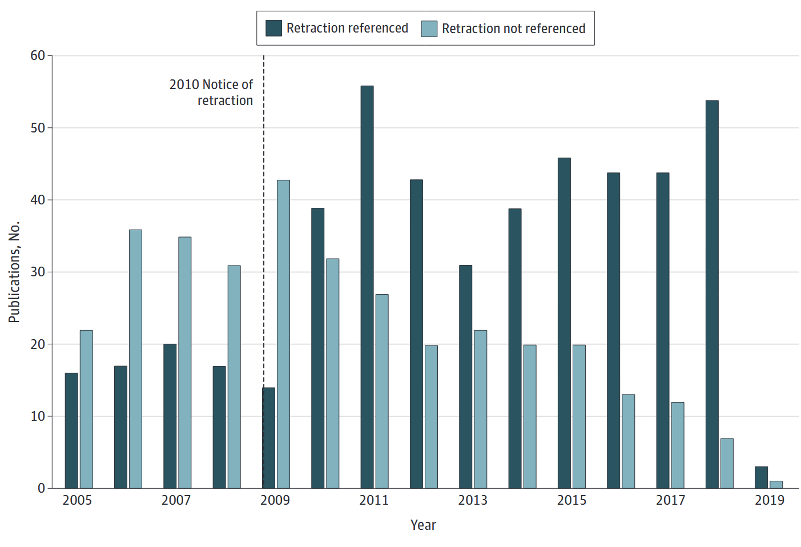
And continue to be influential after retraction
Suelzer JAMA Network Open 2019, doi:10.1001/jamanetworkopen.2019.15552
After retractions
Continued referencing
Retraction often not mentioned
Continues to be referenced outside of the scientific literature
Public discourse
Conspiracy theories
Large and active anti-vaccination movement continues
2

Slide 6
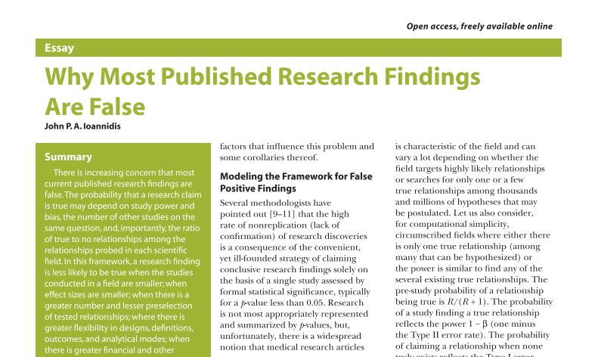

The Ioannadis bombshell, 2005
Ioannidis PLOS Medicine 2005, doi:10.1371/journal.pmed.0020124

Slide 7
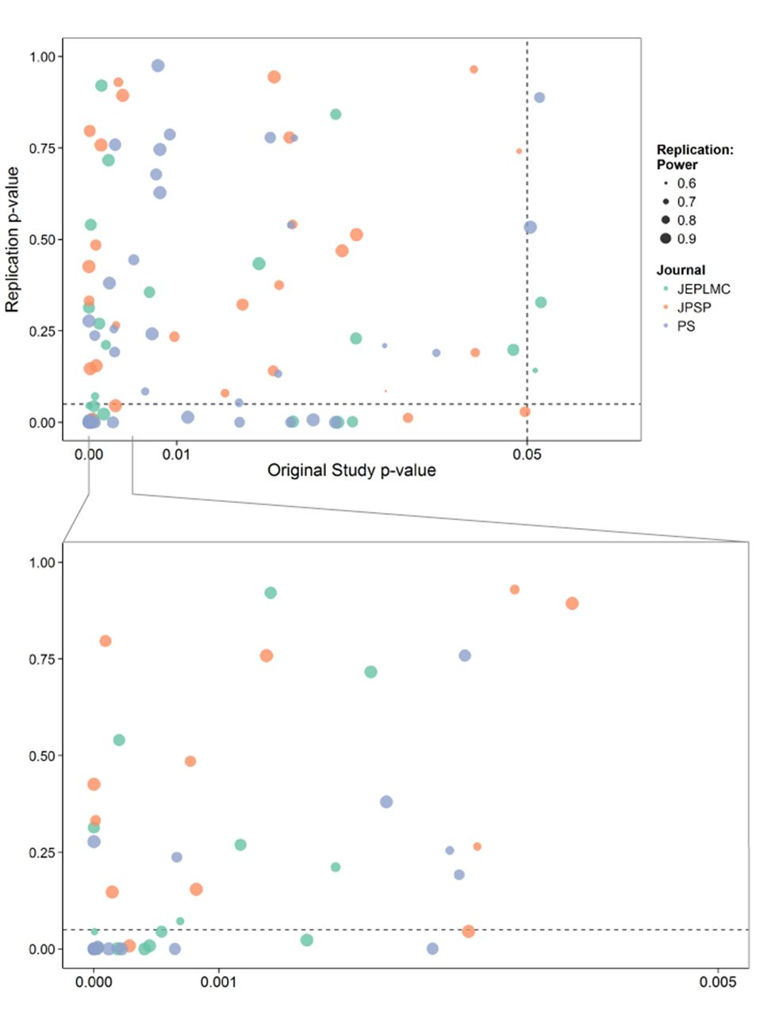
Reproducibility of Psychological Science
Open Science Colaboration Science 2015, doi:10.1126/science.aac4716

Slide 8
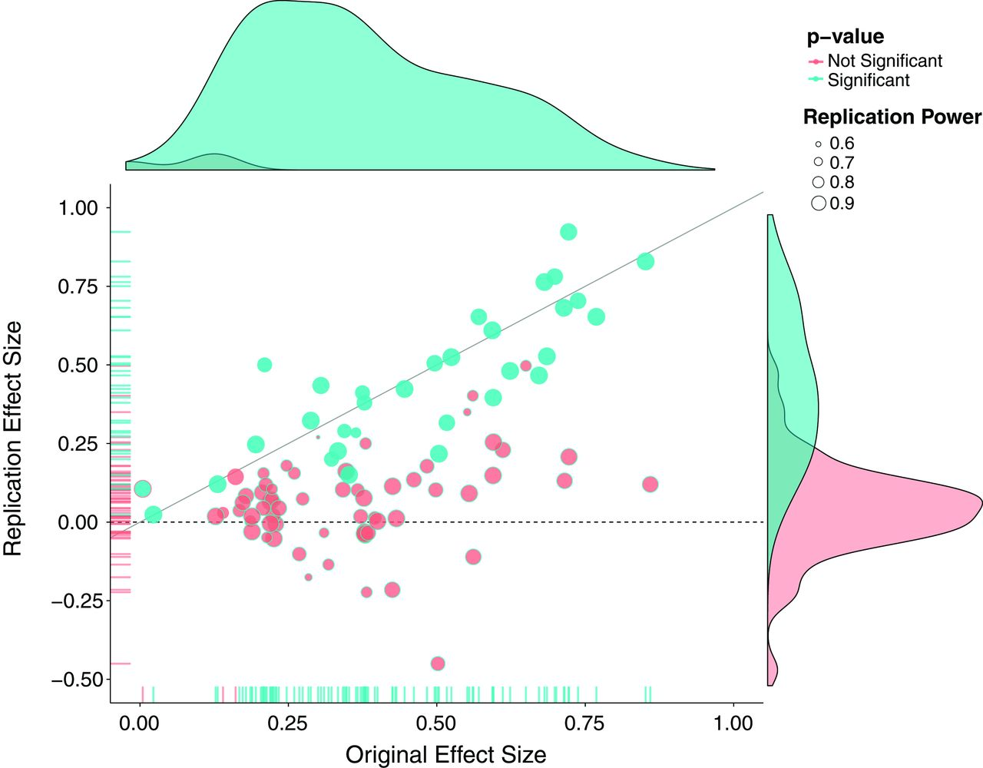
Reproducibility of psychological science
Open Science Colaboration Science 2015, doi:10.1126/science.aac4716

Slide 9
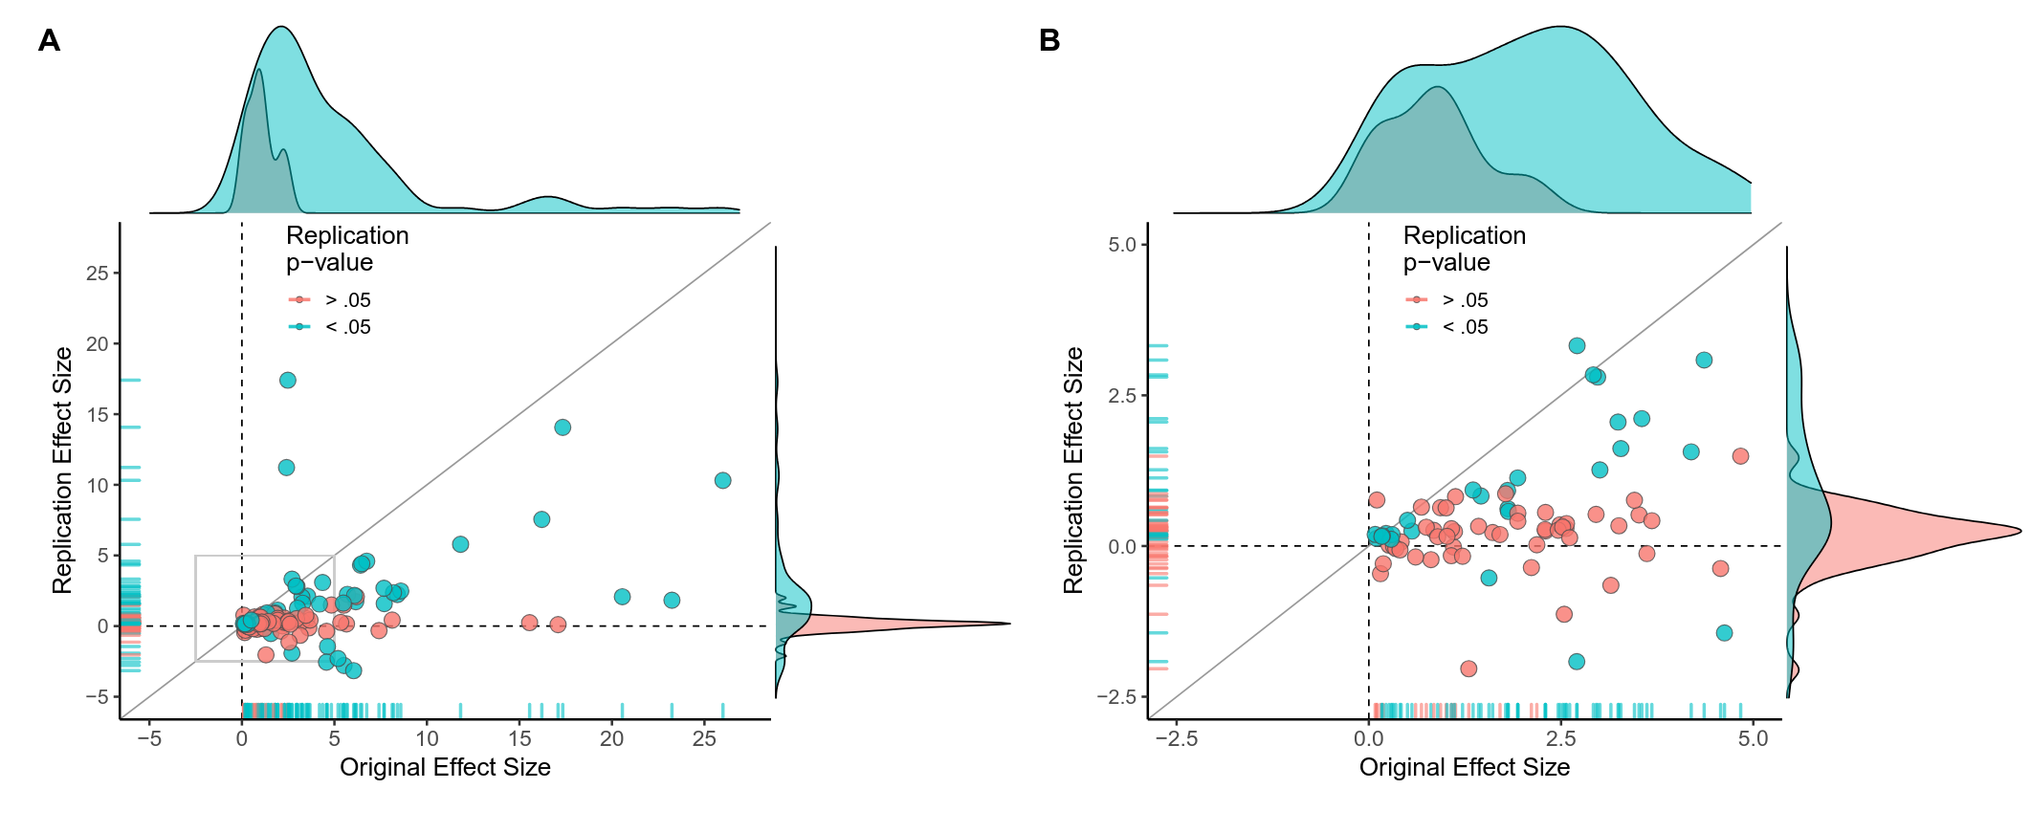
The replication crisis is also in biomedical science
Errington eLife 2021, doi:10.7554/eLife.71601
50 completed replications of experiments in cancer biology
Effect sizes smaller by 85% in replications
Significance replicated 40%
Non-significance replicated 80%
All effects
Effect size < 5

Slide 10
Scientific knowledge is the result of a long pipeline
Our course focused on one step
Plenty of possibilities for error in that step
And also touched on data collection
And the possibility for errors in data collection
Errors can arise in:
Study design
Publication
Knowledge dissemination

Slide 11
12.2 Where do studies come from?
Before science can be done, we need to decide what to do. What is
the process by which scientists actually decide to do a study?

Slide 12
The idealized view of scientific logic is simple
This is a model taught in high schools
It is the model that many scientists actually believe
It is not the reality of where studies come from

Slide 13
Many factors influence the decision to do a study
Missing scientific knowledge
What do we think we know?
What do we need to know?
What new tools are available?
External drive
What do funding agencies want?
What do my friends want to do?
What have we already started?
One serious constraint
What do we know how to do?

Slide 14
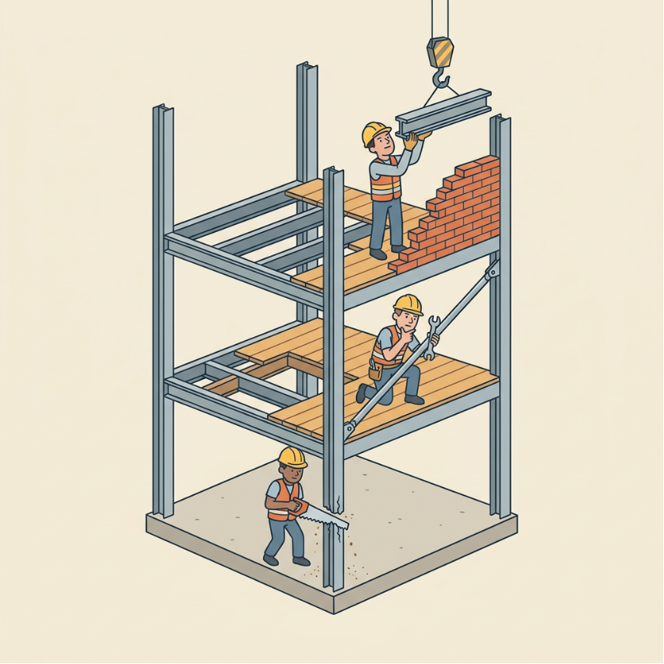
What counts as a scientific question?
We think we know something
But we are probably wrong
We think we know something
But it needs more support
We think we know something
And it is time to make the next step

Slide 15
What counts as an engineering question?
We think we know how to do something
But it doesn’t generalize to an important new application
We think we know how to do something
But it does generalize to an important new application
We think we know how to do something
But this other way may be better

Slide 16
What counts as a clinical question?
We think we know how diagnose / treat some patients
And we want to check if it is really working
We think we know how diagnose / treat some patients
And we want to try it on a new group
We think we know how diagnose / treat some patients
And we want to see if another diagnosis or treatment might be better

Slide 17
Criteria for good study design
There is a central question
With a yes / no answer
That is a real scientific / engineering / clinical question
There is a clear primary measure
That is obviously relevant to the question
The measured value will answer the question
The expected effect size is large
The effect size is the difference between the measure under ‘yes’ and under ‘no’
Previous experience validates
The ability to measure reliably
The existence of a meaningful effect
A prior expectation for a yes or no answer

Slide 18
Pilot data drives studies that drive new pilot data
Pilot data is necessary for
Testing and developing experimental methods
Developing analysis methods
Supporting grant feasibility
Clarifying research directions

Slide 19
12.3 Fragile design
Problems can start even before data anslysis

Slide 20
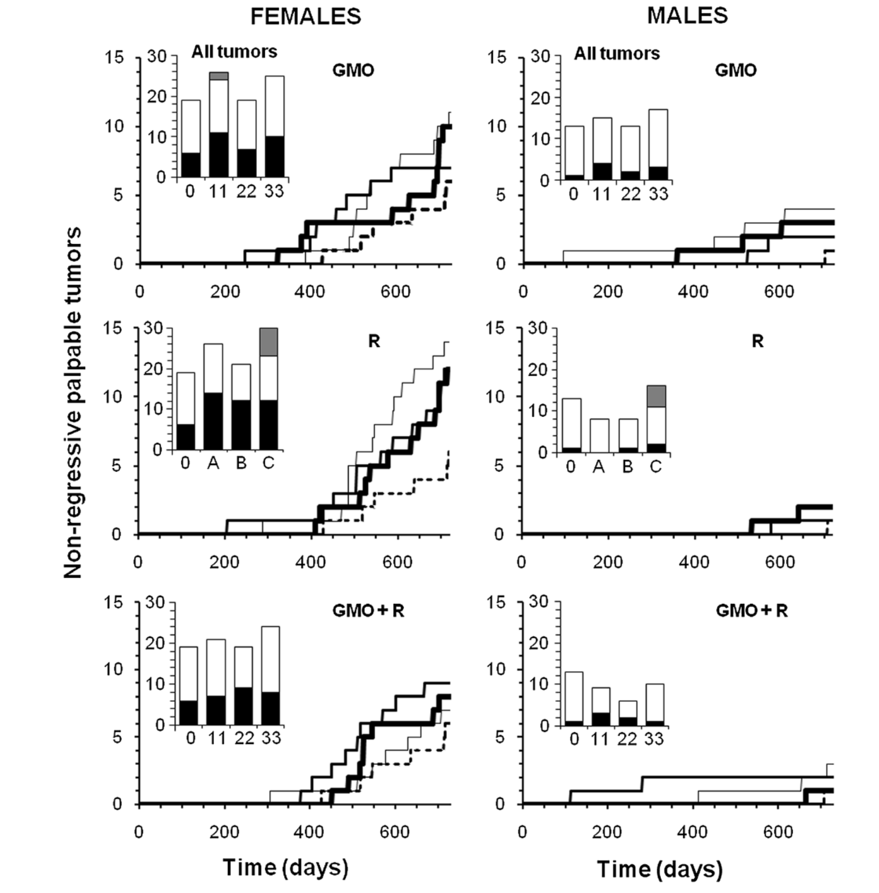
Does genetically modified food cause cancer?
Séralini Environmental Science Europe 2014, doi:10.1186/s12302-014-0014-5
200 rats for 2 years
Male and female
10 groups
With different amounts and types of GM corn in the diet
Measured
34 organs
Blood samples and urine samples at 11 time points
20 blood parameters
16 urine parameters
Tumor incidence
Mortality
Found kidney and liver toxicity starting at 90 days
And escalating to kidney and liver relate deaths

Slide 21
Design is fragile: low power and a large number of measures
EFSA EFSA Journal 2012, doi:10.2903/j.efsa.2012.2986
Small number of rats per group
Large number of measures
Called a ‘fishing trip’
Use of a strain that develops tumors with age naturally
Inadequate statistical methods
Lack of full reporting
Paper originally retracted and then republished
But still derided

Slide 22
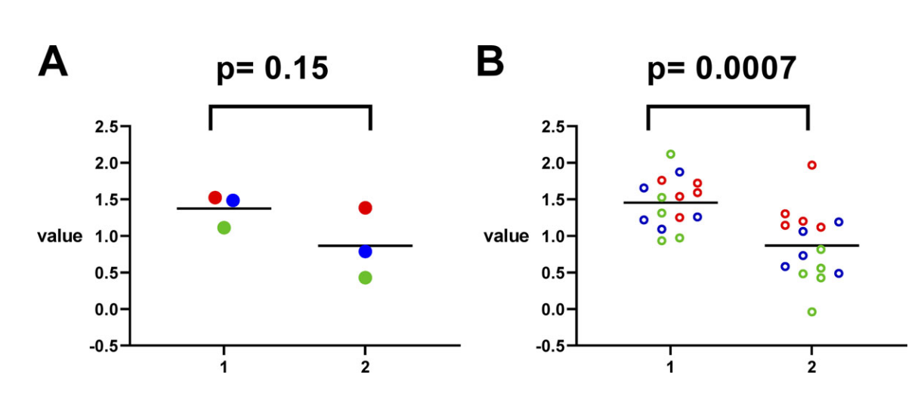
Poor design through pseudo-replication
Eisner J General Physiology 2019, doi:10.1085/jgp.202012826
Inappropriate pooling
Can lead to false confidence
These are different:
5 cells measured in 3 rats
1 measure in each of 15 cells
Very common in neuroscience
Record 500 neurons in each of 2 monkeys

Slide 23
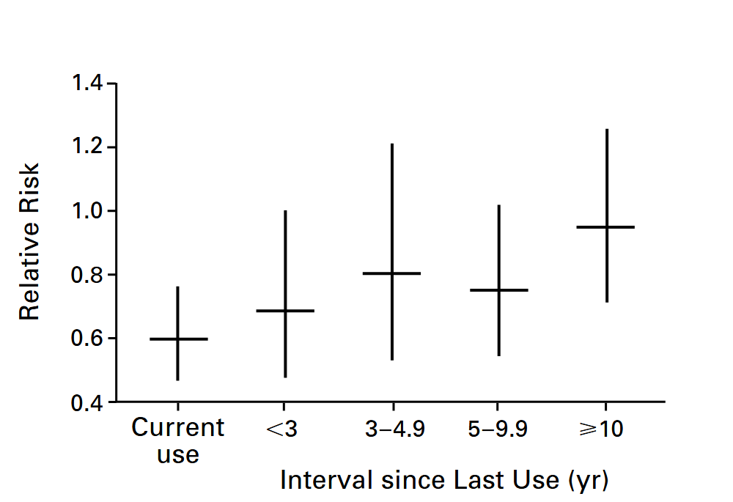
Selection bias in study design
Grodstein NEJM 1996, doi:10.1056/NEJM199608153350701
59,336 women
Followed for up to 16 years
Women who took estrogen with progestin
Lower risk of heart disease
Strong encouragement to use these drugs
What question could there be?

Slide 24
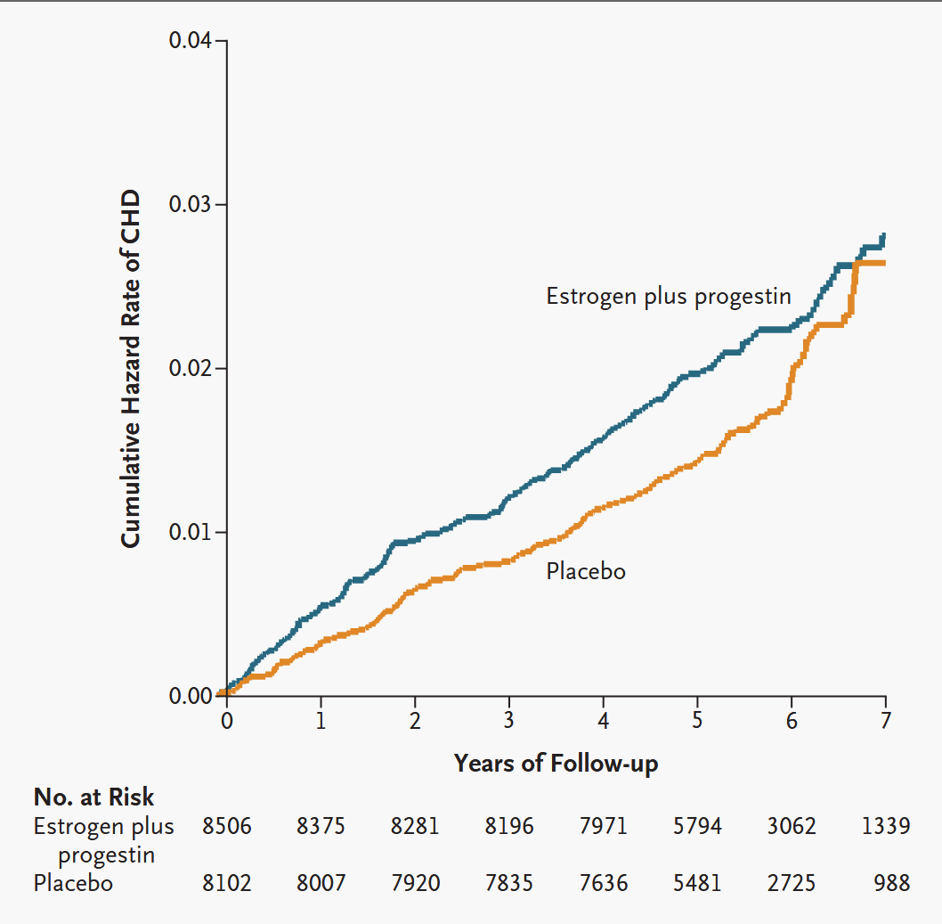
Randomized trial sees opposite result
Manson NEJM 2003, doi:10.1056/NEJMoa030808
Estrogen plus progestin increases cardiac risk
Observational study was not well randomized
Women who choose hormone therapy are not random
Health status
Medical access
Socioeconomic factors
Behavioral differences
Time since menopause

Slide 25
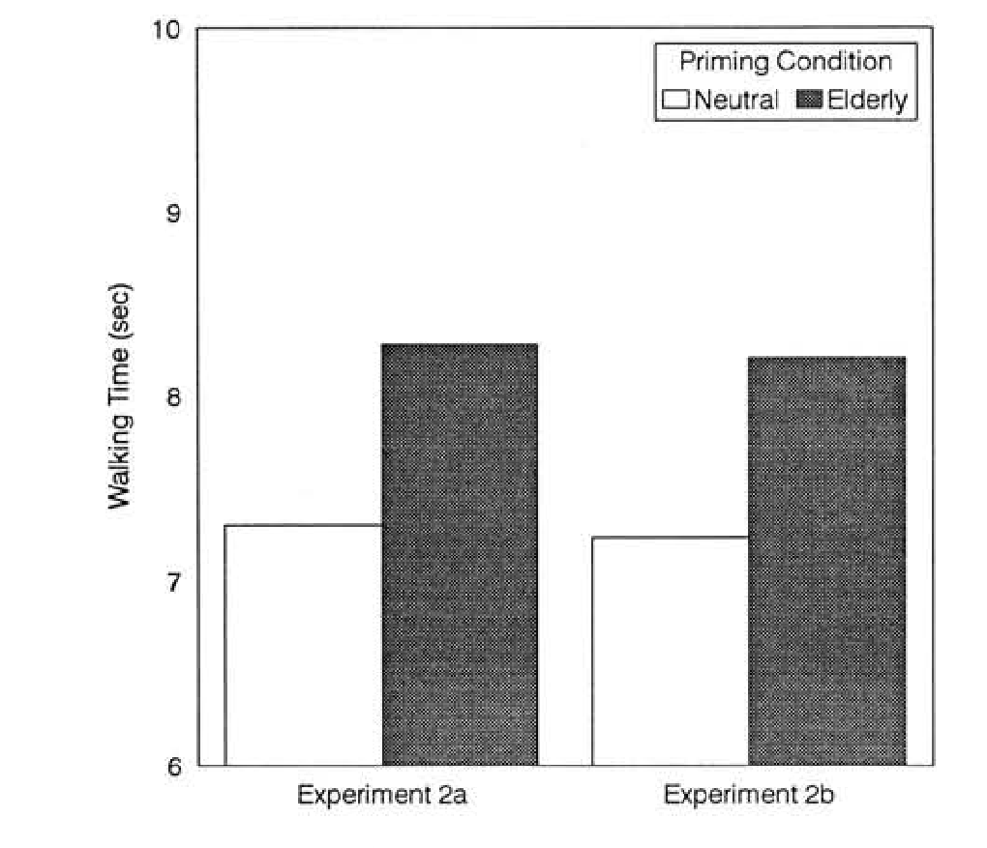
Confounding variables in study design
Bargh J Personality Social Psychology 1996, doi:10.1037/0022-3514.71.2.230
Participants did a distractor task
Unscramble sentences
Two groups
Sentences with neutral words
Sentences with words relevant to being old
But not slow
After the task, walking out of the lab
Subject in the elderly group walked more slowly
Results replicated
Across labs
Across modalities
Across experimental conditions
Priming was an active area of research for 15 years

Slide 26
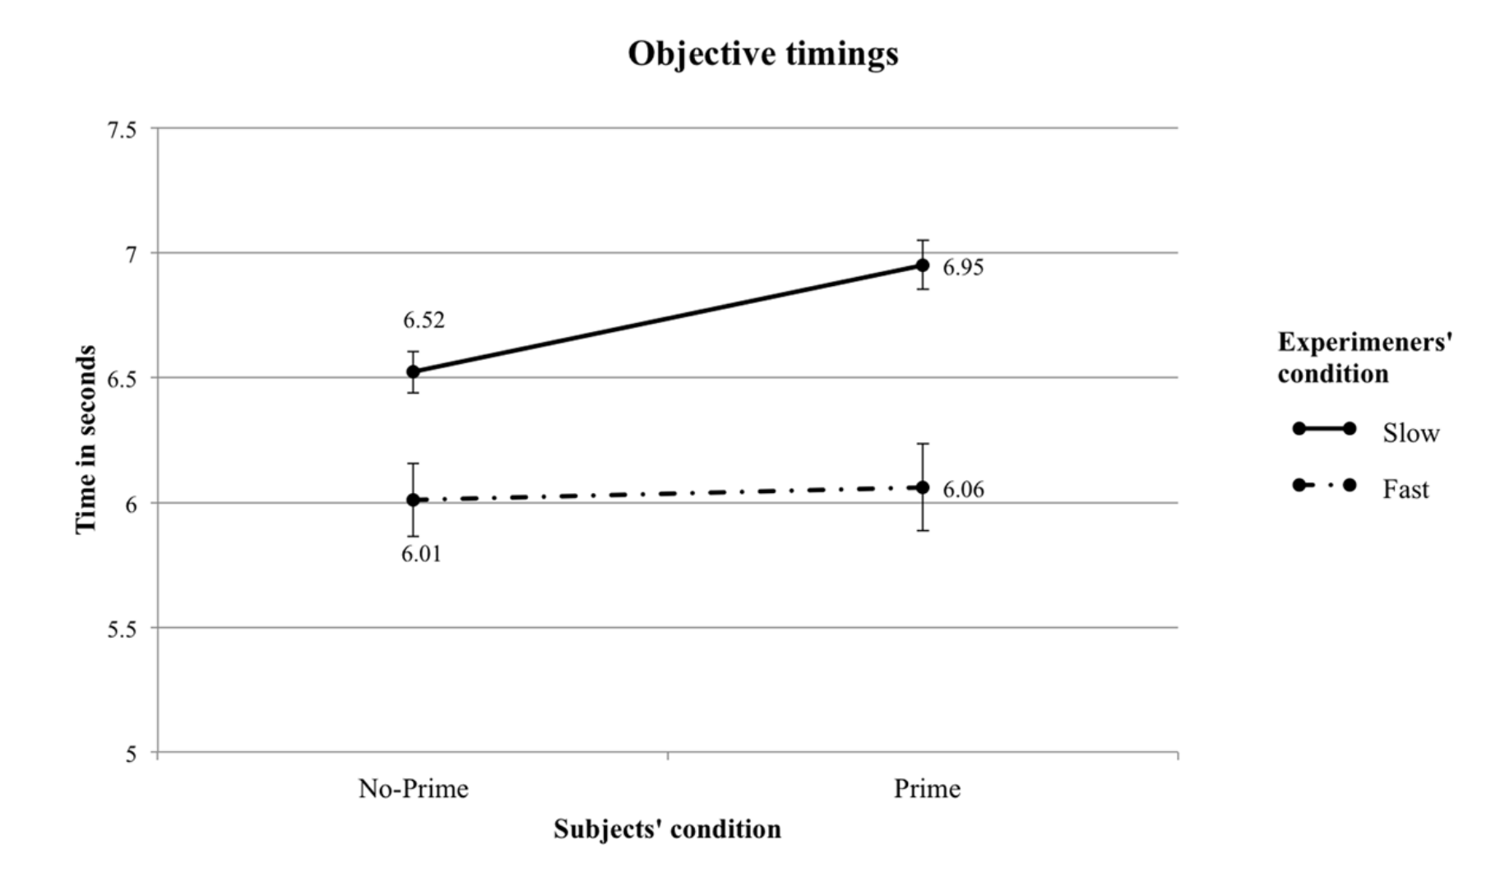
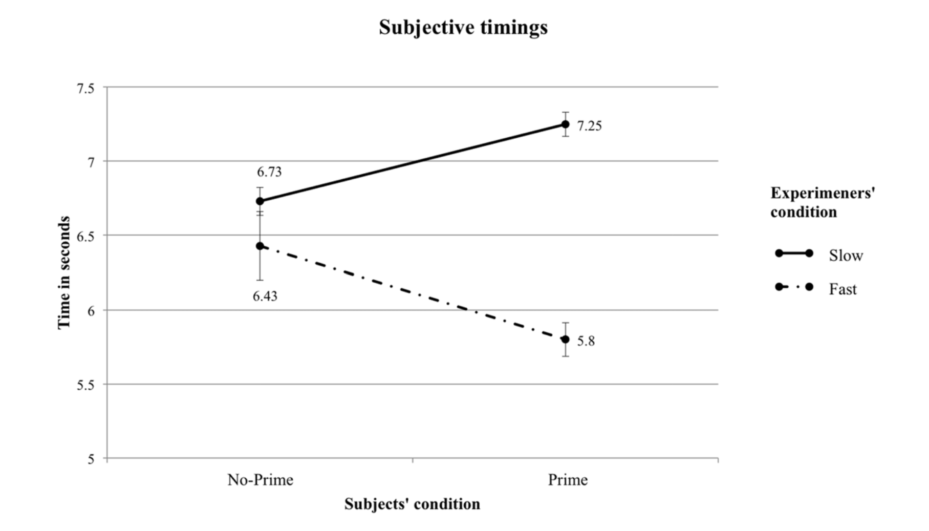
Priming was in the mind of the experimenter
Doyen PLOS One 2012, doi:10.1371/journal.pone.0029081
No effect
If walking time measured objectively
Not by experimenter
Opposite effects
If time measured by experimenter
But experimenter had opposite expectations
Outcome:
the implosion of an entire scientific field

Slide 27
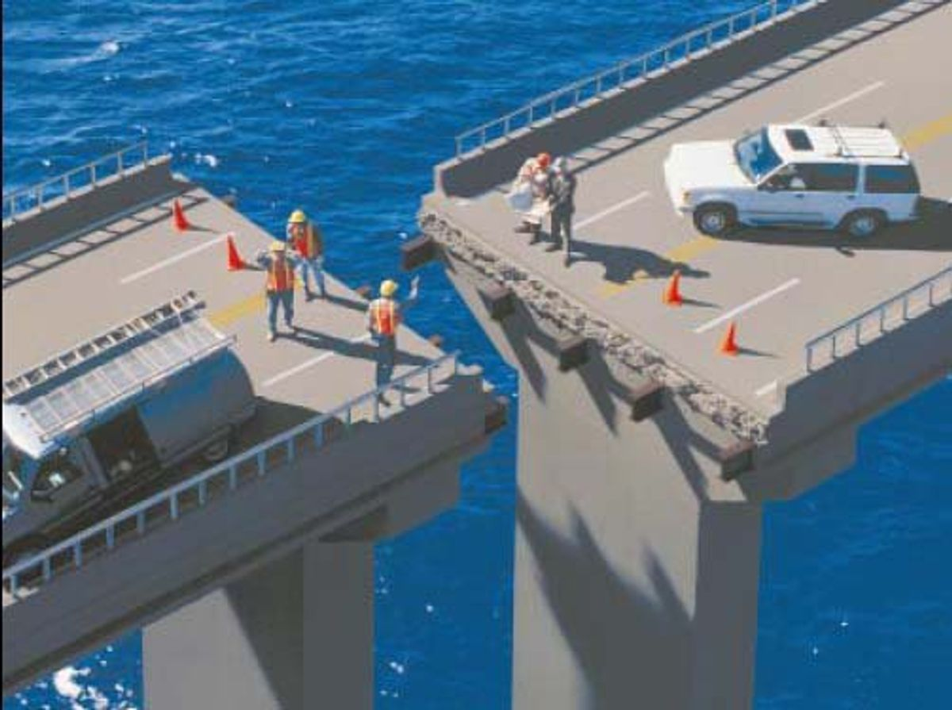
Bad design is hard to fix after data is collected
Scientific groups spend a lot of time thinking about design
Lab meeting discussions
Discussions with other groups
Preliminary / pilot data
Research proposals

Slide 28
12.4 The significance filter
Much of the scientific literature has a significance threshold
and this biases results.

Slide 29
Significance turns an estimate into a finding
Thresholding makes an arbitrary boundary between
“real” findings
“null” findings

Slide 30
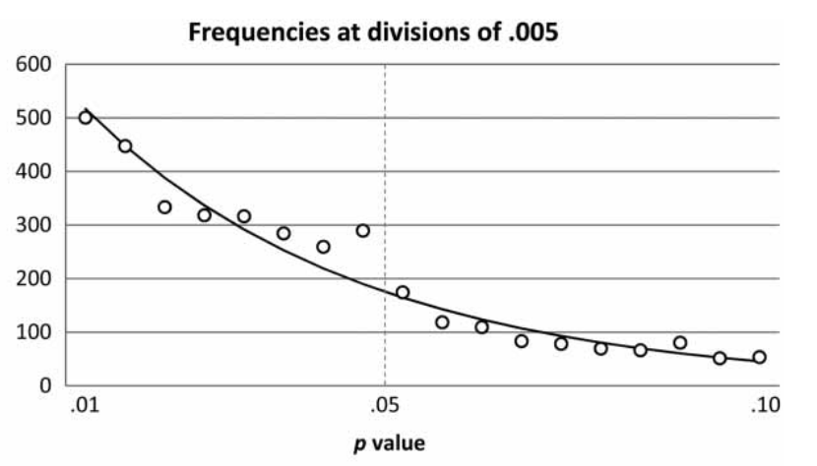
There are excess studies at p < 0.05
Masicampo Q J Exp Psych 2012, doi:10.1080/17470218.2012.711335
Too many published papers have p just below 0.05

Slide 31
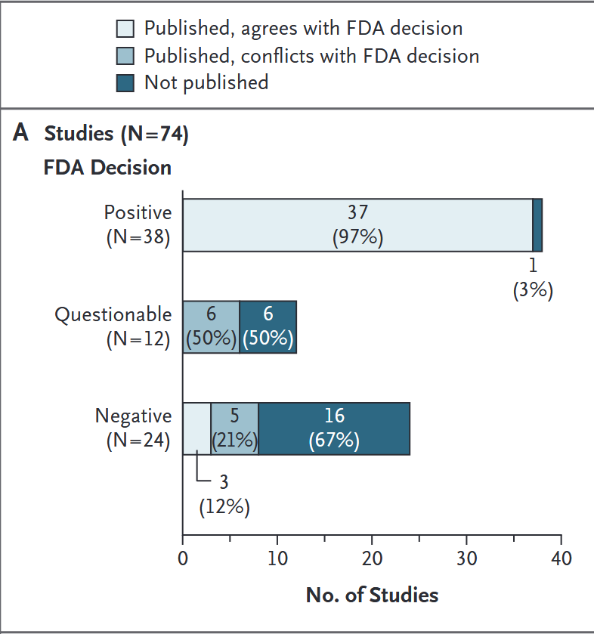
Failed drug trials do not get published
Turner NEJM 2008, doi:10.1056/NEJMsa065779
Examined 74 submissions to FDA
Almost all the approved studies were published
Very few that were not approvded were published

Slide 32
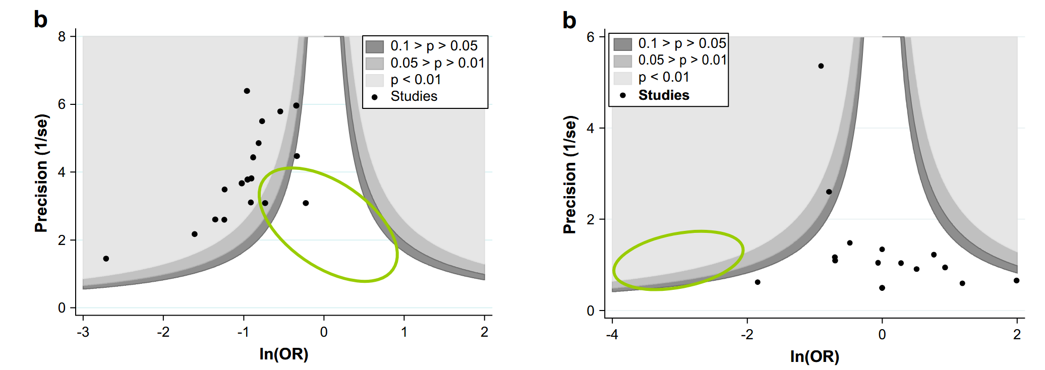
Selection biases which estimates get published
Peters J Clinical Epidemiology 2008, doi:10.1016/j.jclinepi.2007.11.010
The worse the estimate
The larger the effect needed
Studies with:
Low power
Large noise
Small true effect
Only pass threshold with extreme datasets
Apparent real effect
Apparent null effect
Green ellipses show “missing” non-significant studies
Effect size (expected effect is negative)

Slide 33
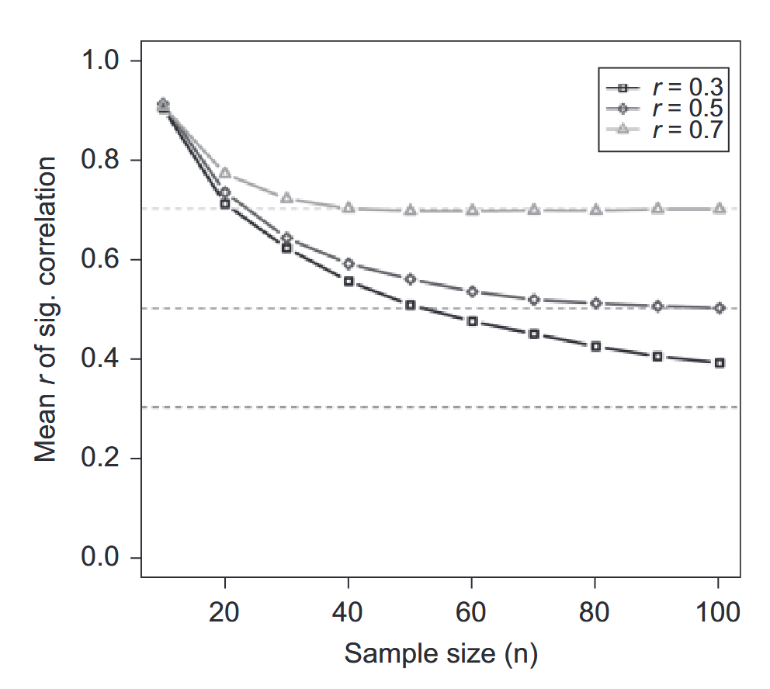
Small effects lead to inflated estimates
Yarkoni Perspectives on Psychological Science 2009, doi:10.1111/j.1745-6924.2009.01127.x
Some fields have very small effects and low power
fMRI
Talk therapy
Without very large samples
Effect sizes will be overestimated

Slide 34
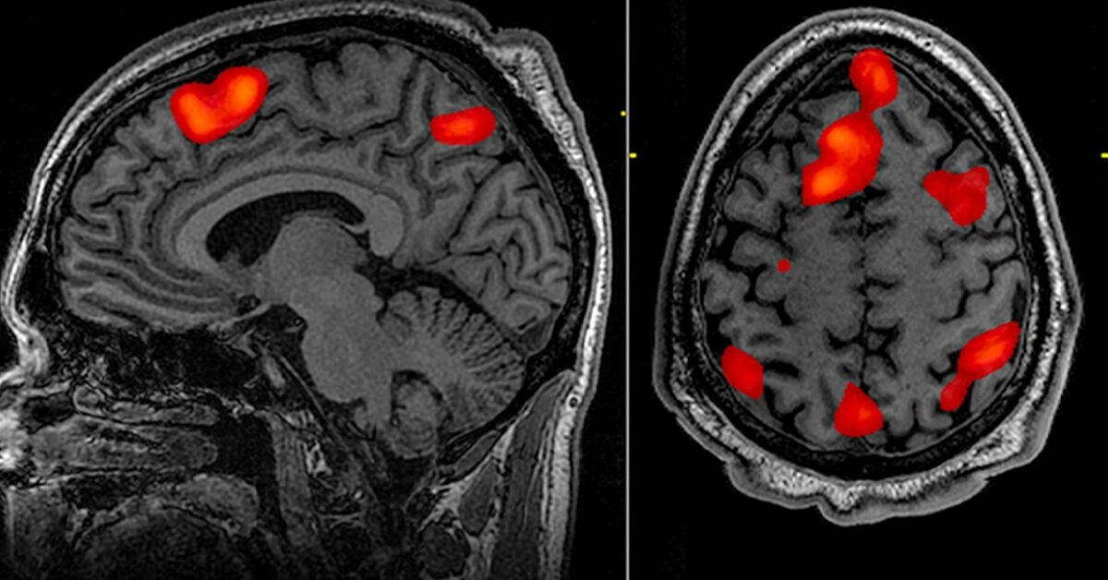
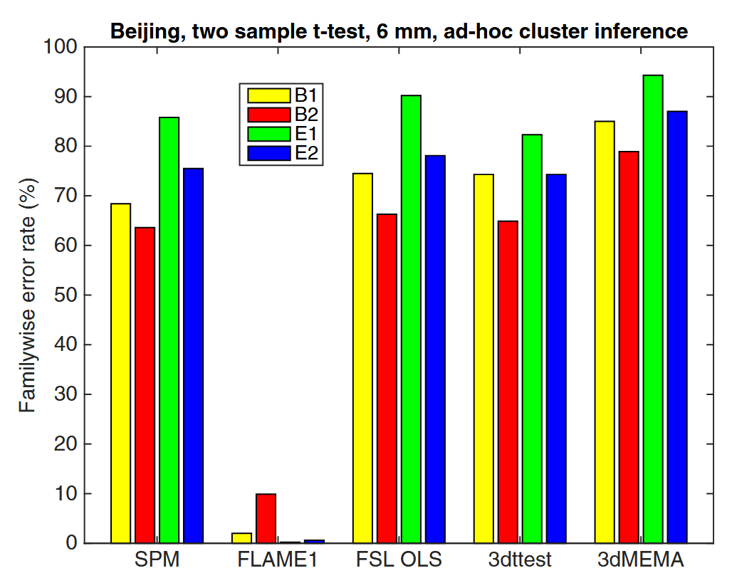
Multiple tests multiply false positives
Eklund PNAS 2012, doi:10.1073/pnas.1602413113
An experiment can involve
Many voxels
Many electrodes
Many cells
Many hypotheses
Correcting the significance is called multiple comparison testing
Many methods
Bonferroni / Sidak
Random field theory
Permutation analysis
False discovery rate
Different answers depending on the method chosen

Slide 35
12.5 The garden of forking paths
Researchers make many choices in their analyses and
this can lead to getting many different results.

Slide 36
Data is analysis involves choices
There isn’t only one way to analyze the data

Slide 37
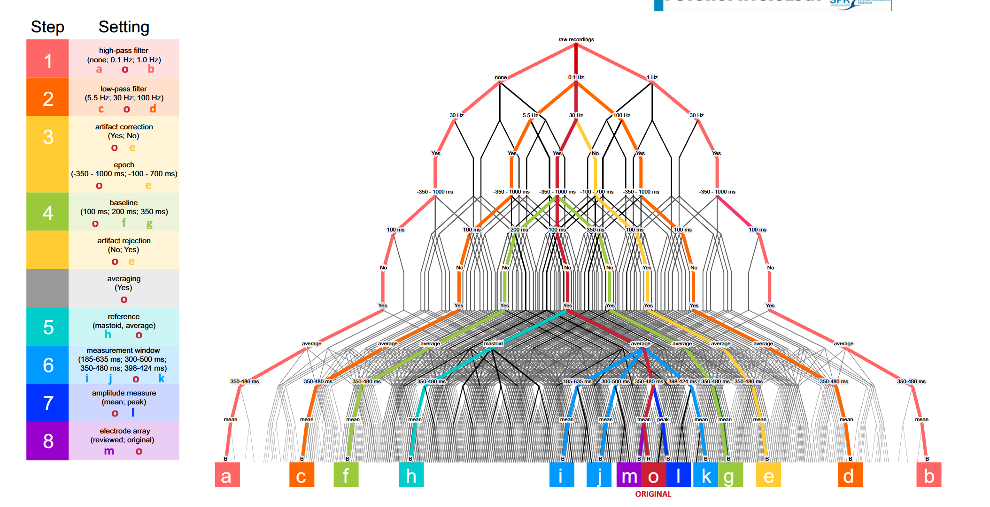
Forking paths in EEG analysis
Šoškić Psychophysiology 2024, doi:10.1111/psyp.14628

Slide 38
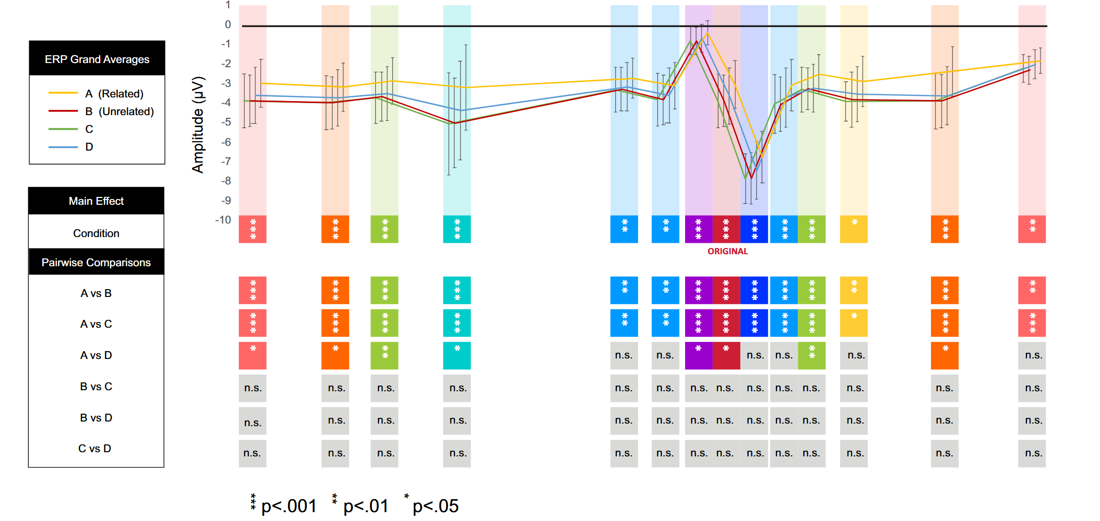
Forking paths make a difference
Šoškić Psychophysiology 2024, doi:10.1111/psyp.14628

Slide 39
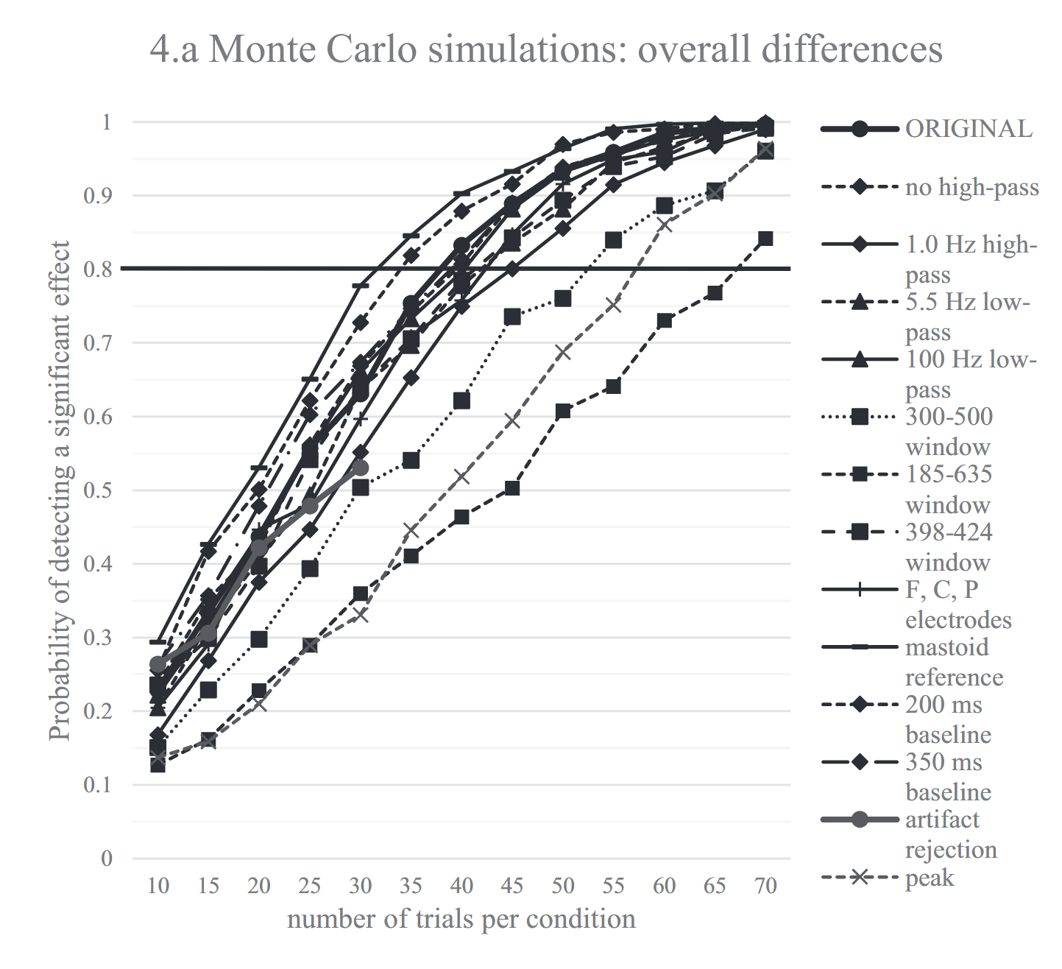
Forking paths affect power and significance
Šoškić Psychophysiology 2024, doi:10.1111/psyp.14628
Choice of analyses can give a power of 0.8 with
30 trials per condition
70 trials per condition

Slide 40
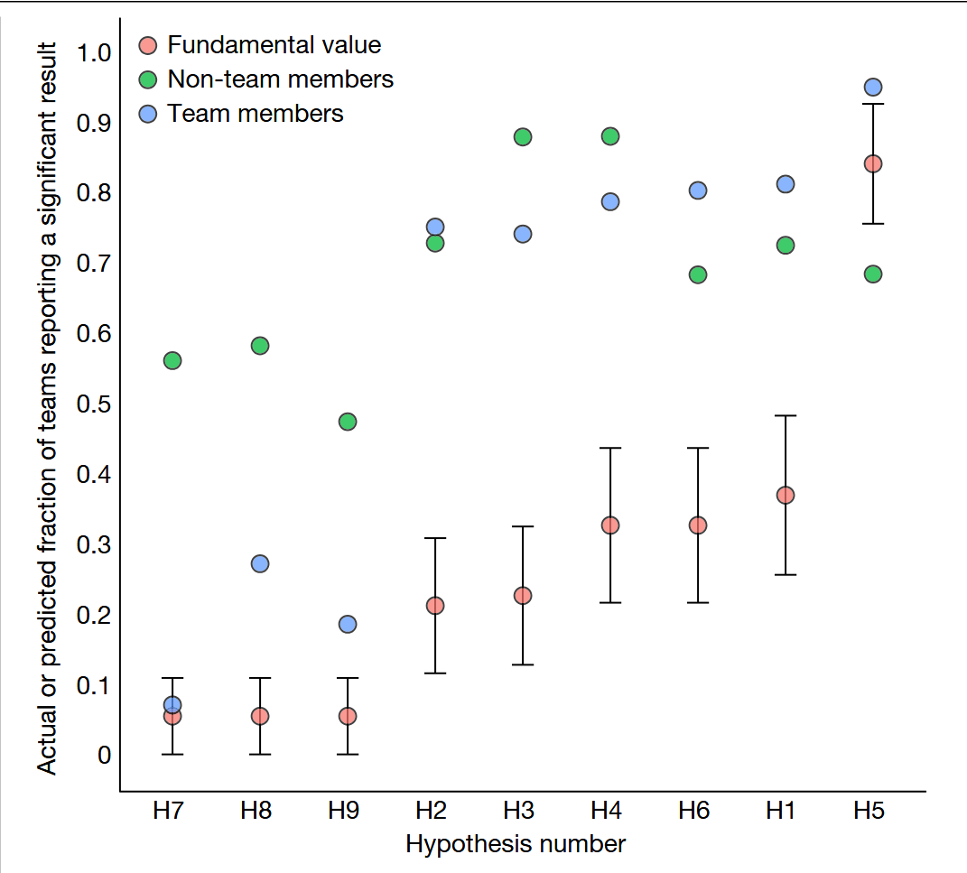
Experts make different choices
Botvinik-Nezer Nature 2020, doi:10.1038/s41586-020-2314-9
Gave raw MRI data to 70 teams
Each team tested 9 hypotheses
Each team bet on whether each hypothesis was correct
Non team members also bet
Each team used a different pipeline
For most hypotheses
Disagreement on significance
For all researchers
Overly optimistic about results

Slide 41
In traditional reporting all the unused paths are invisible

Slide 42
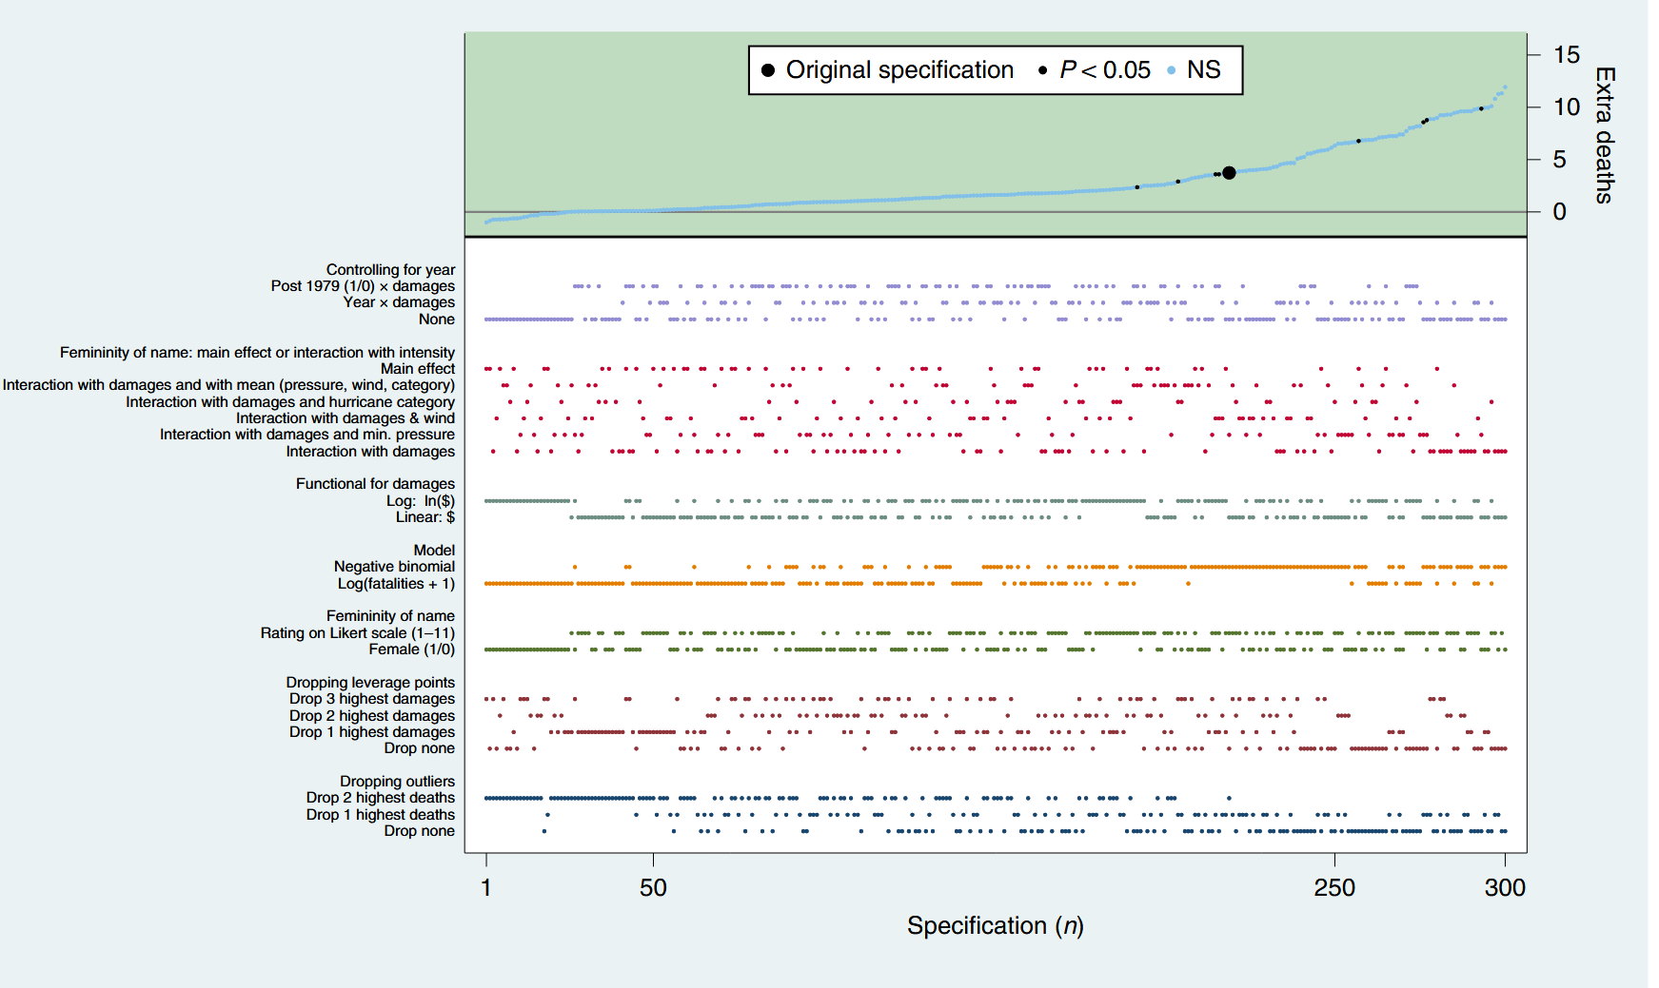
Specification curves can make forking paths visible
Simonsohn Nature Hum Behavior 2020, doi:10.1038/s41562-020-0912-z
Also called a multiverse analysis
Try all combinations and explore mean and variability

Slide 43
12.6 Questionable Research Practices
There are so many ways of doing things wrong

Slide 44
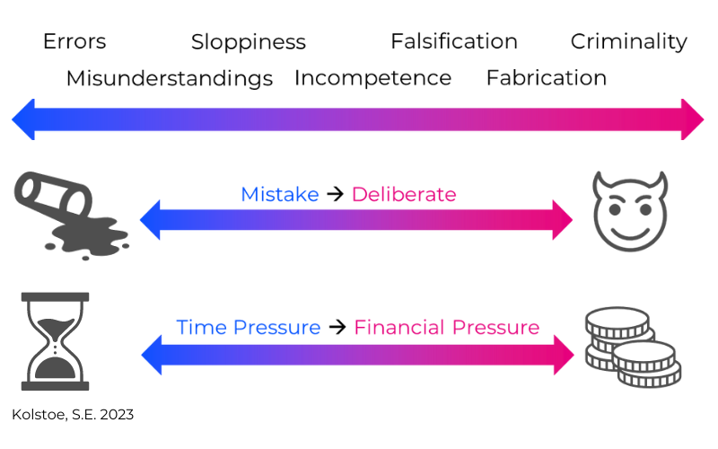
Bad research can be unintentional

Slide 45
Central scientific values
And the questionable practices they guard against

Slide 46
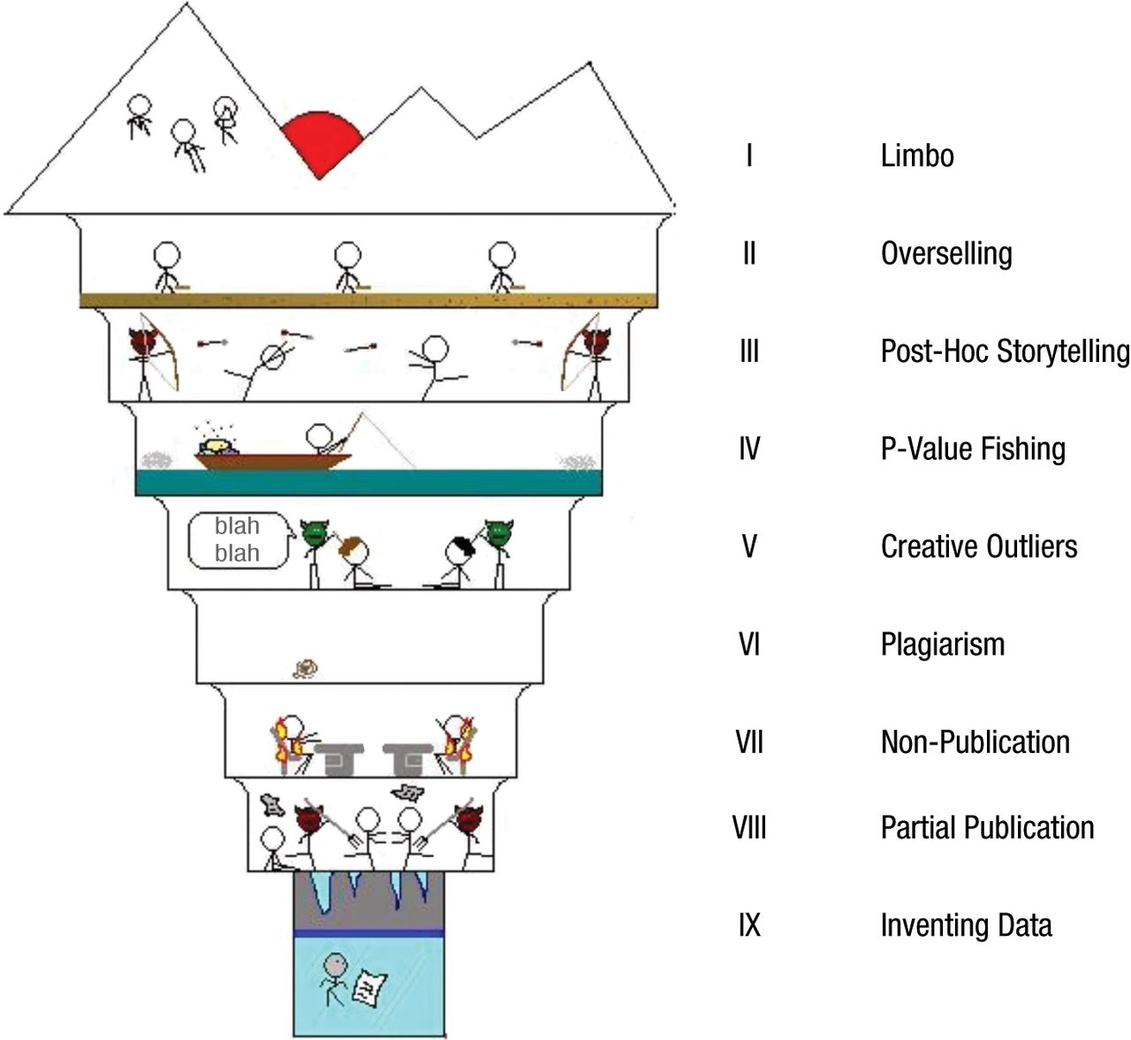
Questionable Research Methods

Slide 47
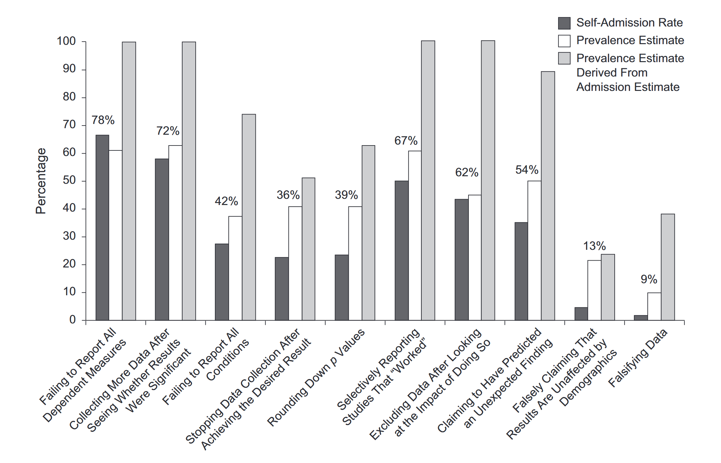
How prevalent are QRPs?
John Psychological Science 2012, doi:10.1177/0956797611430953
Some are much more prevalent than others

Slide 48
p-hacking is one of the most problematic QRPs
Problematic because:
Widespread
Hard to catch
Easy to do
The damage is under-appreciated

Slide 49
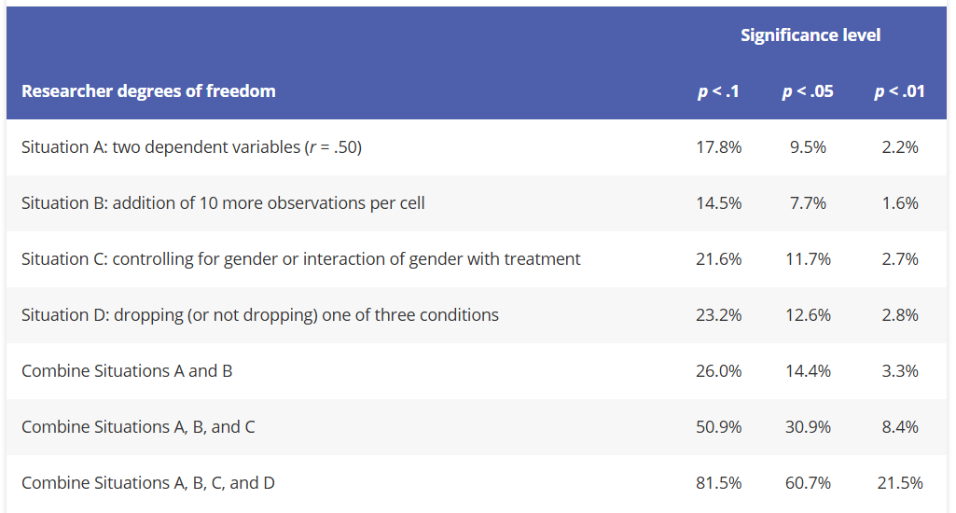
Simulation of p-hacking and significance
Simmons Psychological Science 2011, doi:10.1177/0956797611417632

Slide 50
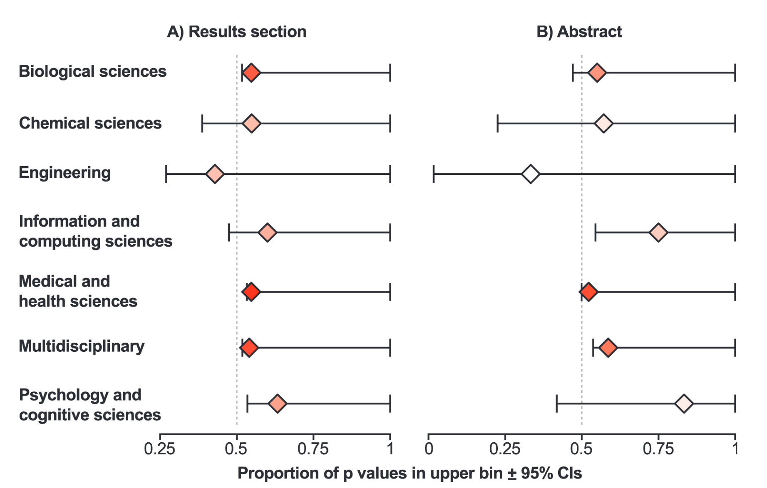
Prevalence of p-hacking
Head PLOS Biology 2015, doi:10.1371/journal.pbio.1002106
Discussed already regarding a biased literature
Now seen as violation of scientific values

Slide 51
HARKing is QRP to some but not to others
Hypothesizing After the Results are Known
Maybe it is good storytelling and smart framing
Maybe it is trying to give your story unwarranted support
Storytelling is honest
Lying is not

Slide 52
12.7 Exploration and Confirmation
Two extreme models of science provide a bit of clarity

Slide 53
Science can be categorized as exploratoration or confirmation
Exploratory science
Don’t know what we expect to find
Don’t know how to do the analysis
Willing to make up a story afterwords
Confirmatory science
Strong evidence already exists
Analysis well established
Story already public knowledge

Slide 54
Exploration, confirmation and harking

Slide 55
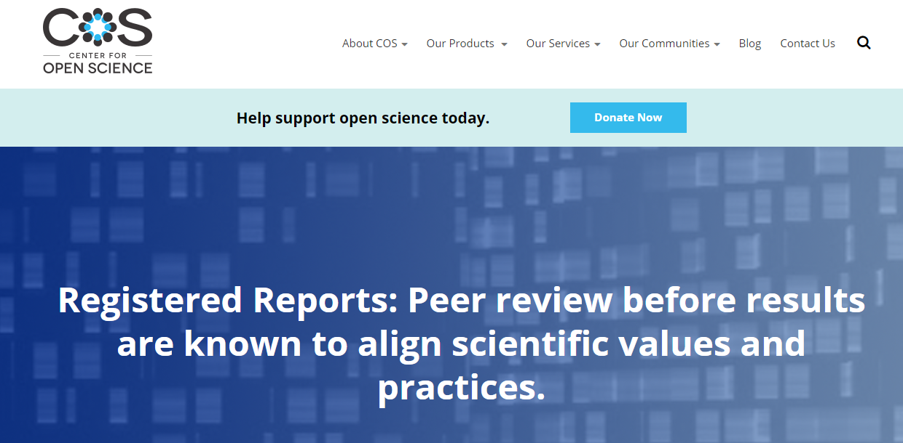
Pre-registration may reduce forking paths

Slide 56
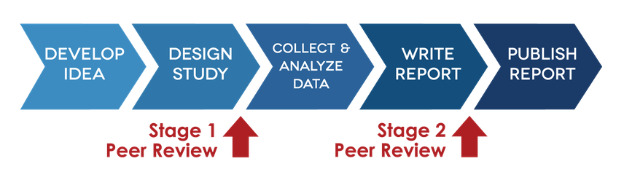
Preregistration is a way of creating a timestamp
Stage 1 review
Review science without knowing results
Stage 2 review
Check that methods have been followed

Slide 57
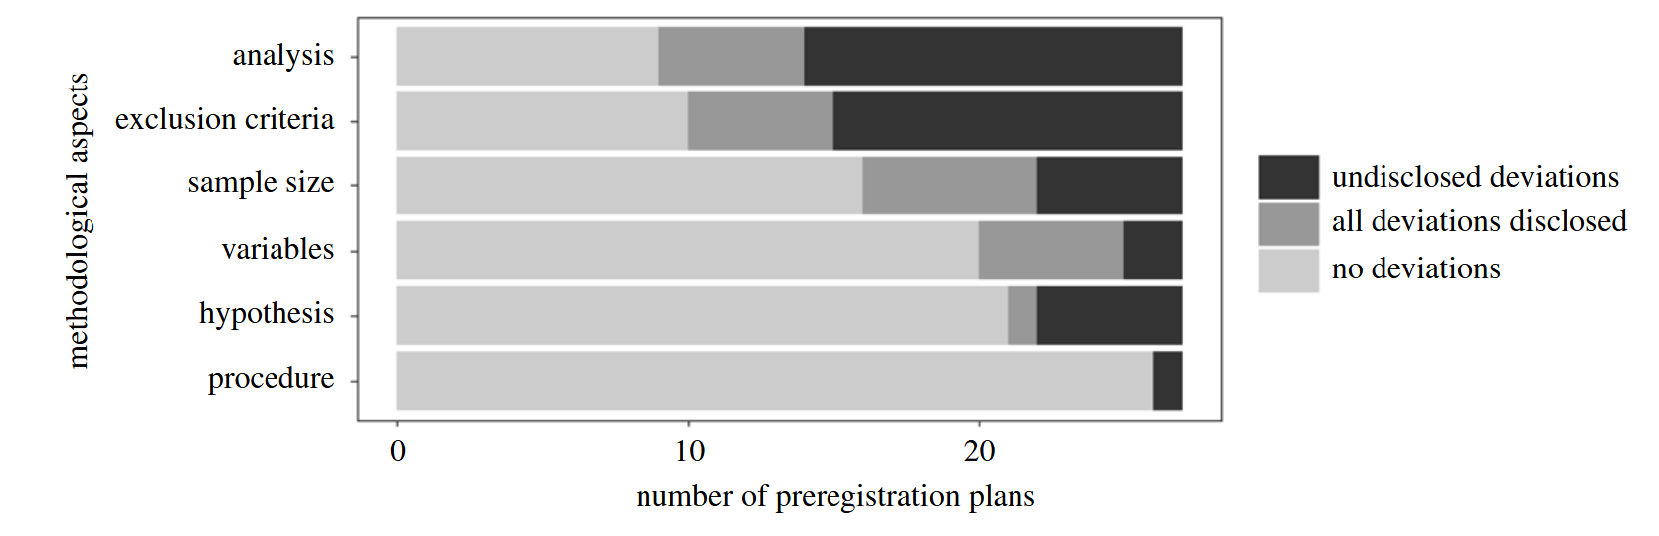
Deviations are common in pre-registered reports
It is allowed if it is disclosed
Shifting the study more towards exploration

Slide 58
12.8 Creating the literature
Once a study is complete: how do other scientists learn
about it?

Slide 59
A long path leads from results to acceptance

Slide 60
There are many forms of ‘literature’

Slide 61
Peer review
Paper sent to 2-3 readers
They send comments
Authors fix comments
They send comments again
Authors fix comments
Eventually someone gets tired
Author can go to a different journal
It may send to the same referee
It may go to someone worse
Referee can ask not to receive the paper again

Slide 62
Reviews
Review papers can serve different purposes
Organize the literature
MSc or PhD project to get oriented
Make a point
Researcher trying to convince the community
Sell oneself
Researcher trying to have a larger impact
Establish a narrative
A reference to use in making the case for feasibility or scientific interest
Modern reviews are often meta-analysis
Quantitative review of the literature
Aggregation of significance and effect sizes across studies

Slide 63
12.9 Incentives and publication bias
How does the structure and the incentives of the system
bias the literature?

Slide 64
It is always easier to publish positive results
The literature needs to be interesting to scientists
Our understanding needs a story
Negative results can be poor technique
Harder to prove the lack of an effect

Slide 65
Preregistration may change literature bias

Slide 66
Incentives for the scientist
Everything depends on publications
Getting hired
Getting promoted
Getting funded
Getting students
Who can do experiments so that there can be more papers
Institutions are also incentivized
Budgets
Special projects
Hiring quality faculty

Slide 67
12.10 Transparent reporting
Contributing to the literature in a way that makes it better

Slide 68
When do you need to report statistics?
Scientific reporting
Scientific paper
Grant application
Pre-registered research
Ethical approval
Medical reporting
Approval for drug or treatment
Ethical approval
Engineering
Patent application
Ethical approval

Slide 69
Different reporting standards
There are often strict rules about statistical reporting
Always check
When there are no rules, there are norms
Reporting for clinical trials is strict
Reporting for registering experiments is relaxed
Rules and norms change over time
Check recent publications or applications

Slide 70
General reporting guidelines
Three levels
Document
Appendix
Repository

Slide 71
General reporting guidelines
Three levels
Document
Methods
Results
Appendix
Repository
Methods:
Brief description of model
Brief statement on prior selection
Statement of diagnostics used
Methods for model comparison or hypothesis test
Results:
HDI for each important parameter
HDI, ROPE (if applicable), and effect size for important comparisons
Model comparison table if appropriate

Slide 72
General reporting guidelines
Model description:
Model description with equations and diagram
Full specification of priors with statement on prior selection
Sampling algorithms and parameters of those algorithms
Three levels
Document
Methods
Results
Appendix
Model description
Diagnostics
Results
Repository
Diagnostics:
Prior predictive plots and statistics
Diagnostic plots and statistics
Posterior predictive plots and statistics
Results:
Table of parameters with
Mean
HDI
ESS and MCSE
Prior or prior HDI (if applicable)

Slide 73
General reporting guidelines
Data:
Raw or preprocessed data should be in a public repository
Three levels
Document
Methods
Results
Appendix
Model description
Diagnostics
Results
Repository
Data
Code
Additional analyses
Code:
A Python notebook or script that runs all relevant analyses
From raw data
Through modeling and diagnostics
And through posterior plotting and interpretation
To statistical inference and model comparison
Notebook should reproduce all figures and computations in the paper
Additional analyses
Analyses that did not make the paper
Additional models
Alternative prior

Slide 74
A summary of the role of each part

Slide 75
12.11 Ownership of the workflow
Understanding the process of science allows one to work
effectively and meaningfully, but it requires taking ownership of
the entire process

Slide 76
A complete workflow

